Slide 1
Sleep after Dungeon
Concept and storyboard

Slide 2
Inscribed Narrative
Premise
Top-down dungeon crawler pseudo rogue-like RPG

Slide 3
Inscribed Narrative
Setting
A fantasy world with monster-filled dungeons and adventurers that explore and conquer said dungeons for fame and fortune. Dungeons have multiple floors that get more dangerous the lower you descend. In one of 5 extremely dangerous and famous dungeons where only the most veteran adventurers can explore.

Slide 4

Inscribed Narrative
Character
Unnamed knight that is strong enough to be in the final floor of the previously mentioned dangerous dungeon. By default wields a sword, but is proficient in other weapons once unlocked by the player. They can not die.
“There ain’t no rest for the wicked.” - Cage the Elephant

Slide 5
Inscribed Narrative
Plot
Player takes control of the knight as he encounters a hostile force in the final boss room of the dungeon. The knight is killed, but instead of staying dead he climbs out of the afterlife and finds himself revived somewhere in the upper floors of the dungeon. The knight must fight their way back through the dungeon defeating floor bosses and encountering other adventurers before having a rematch with their killer and completing their REVENGE.

Slide 6
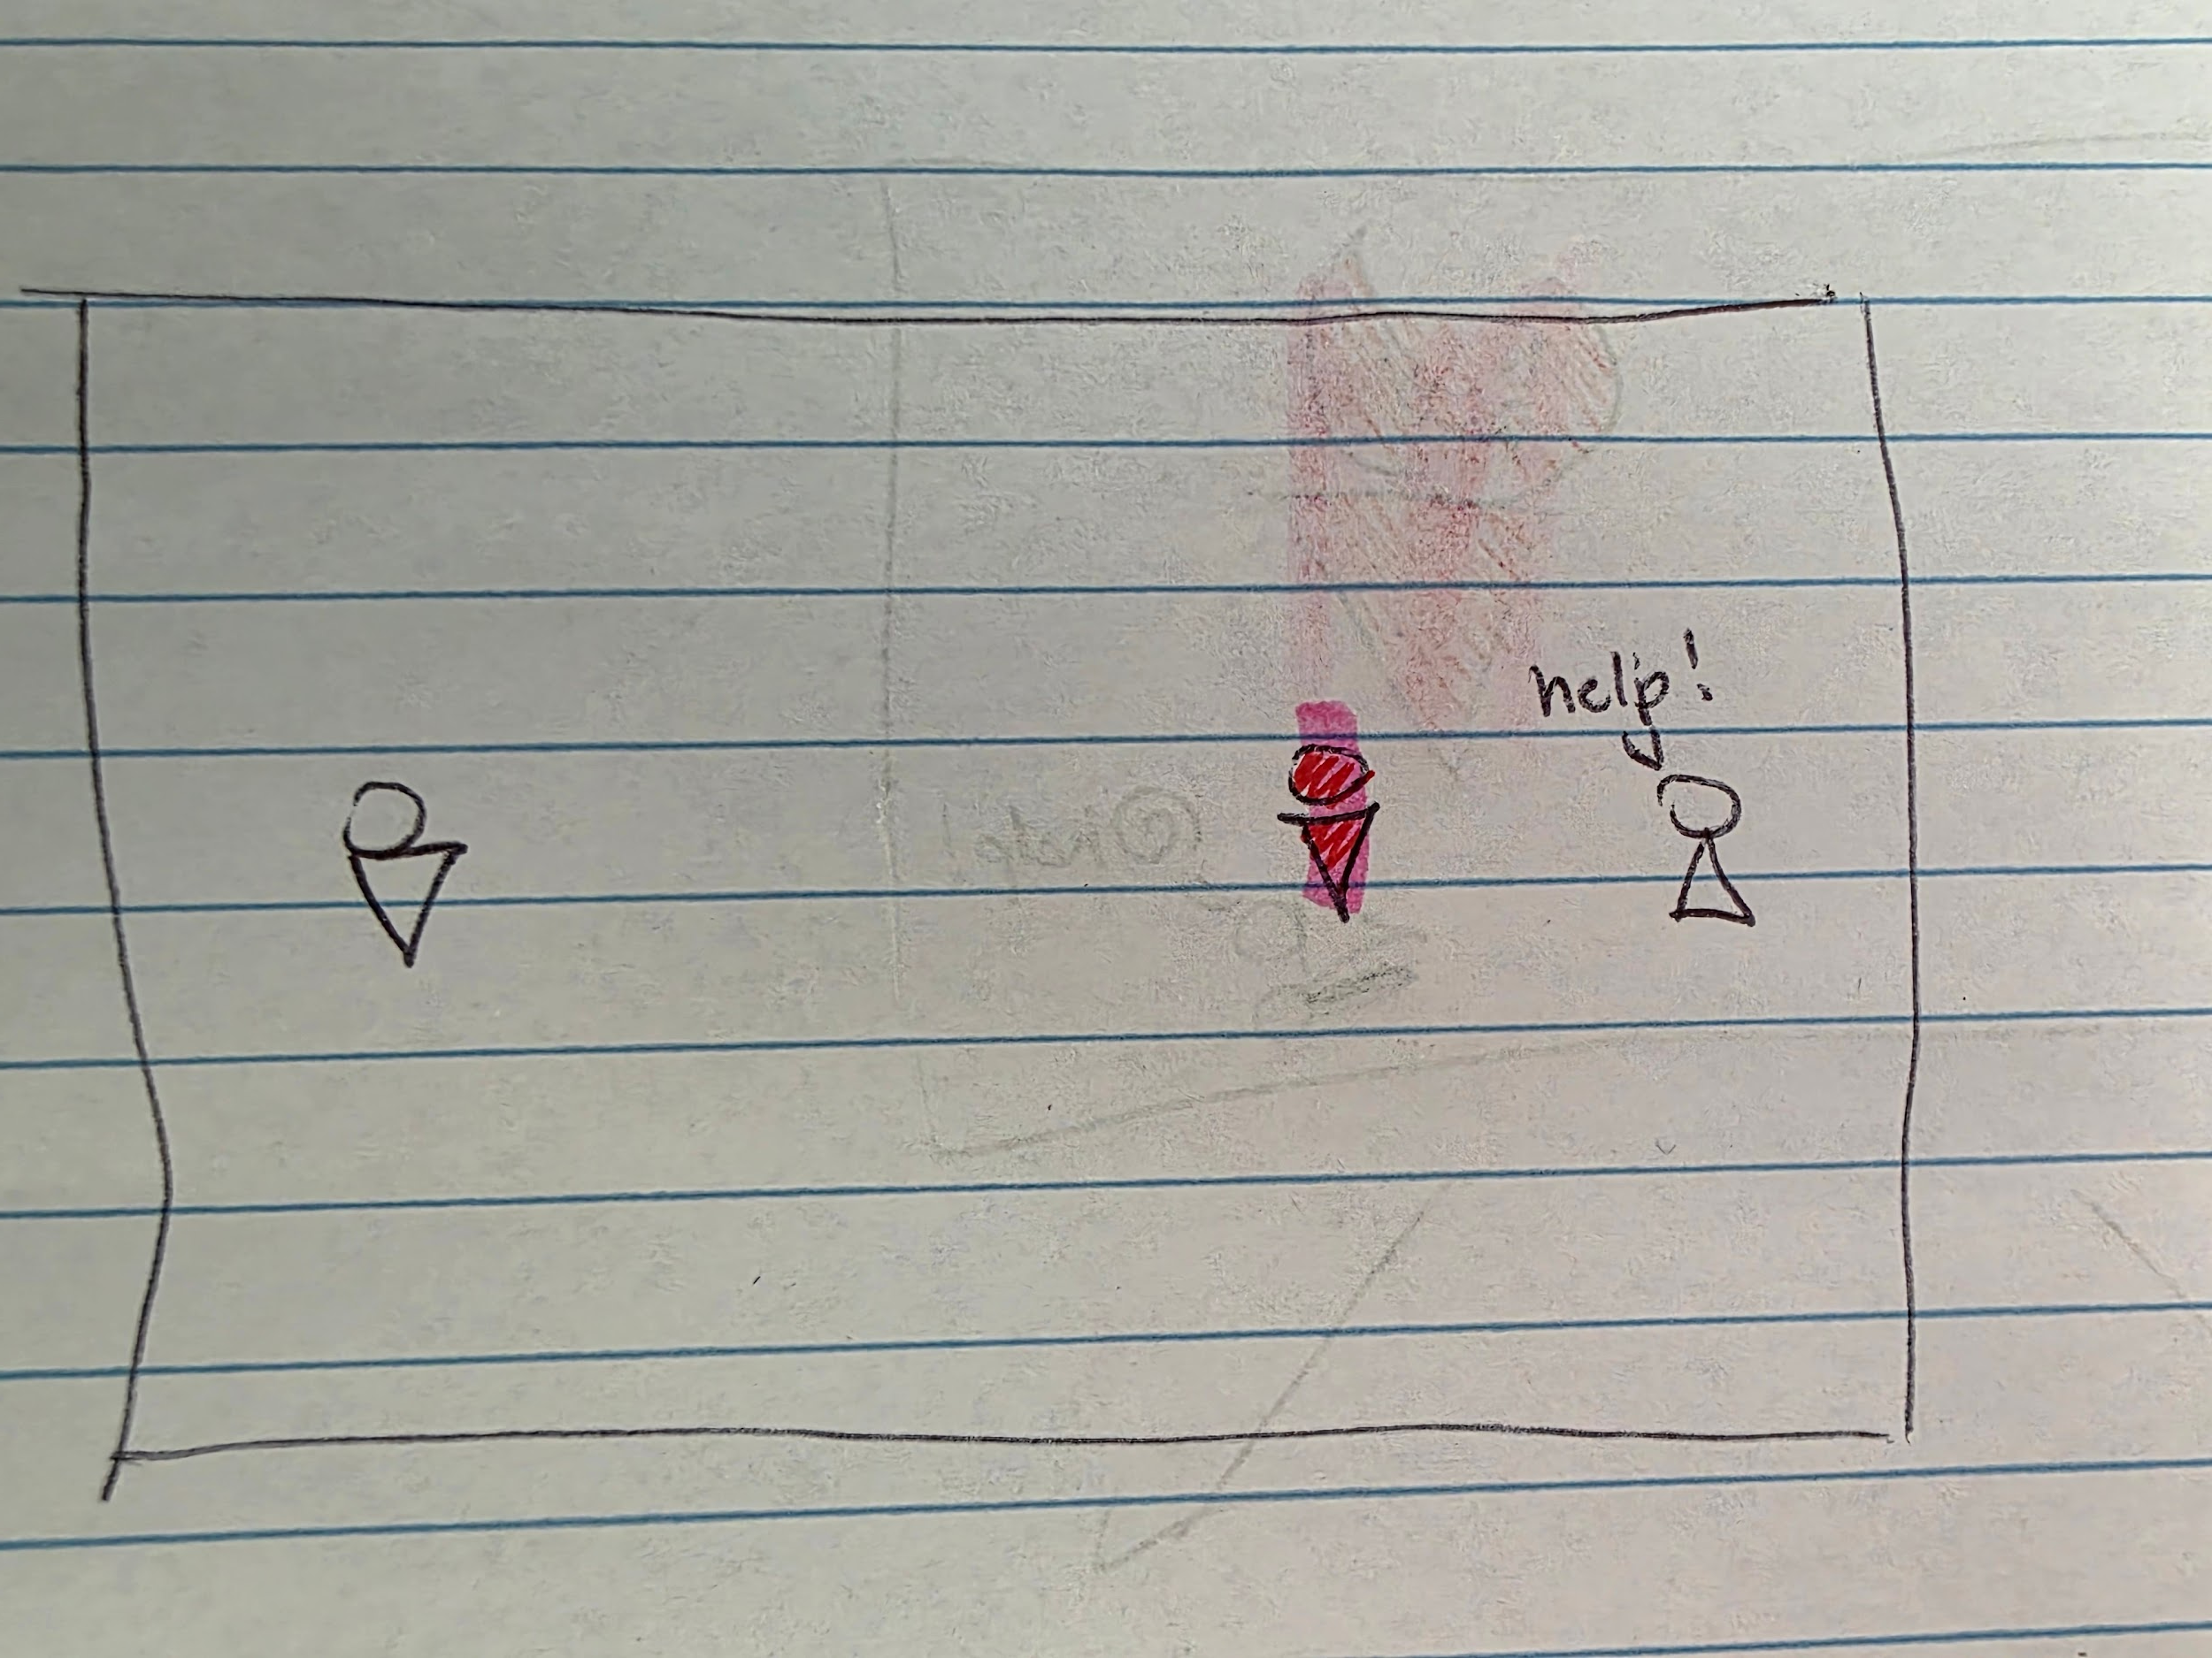
Inscribed Narrative
Exposition
Knight fights hostile enemy in the final boss room of the dungeon. There is also an NPC calling for help.

Slide 7
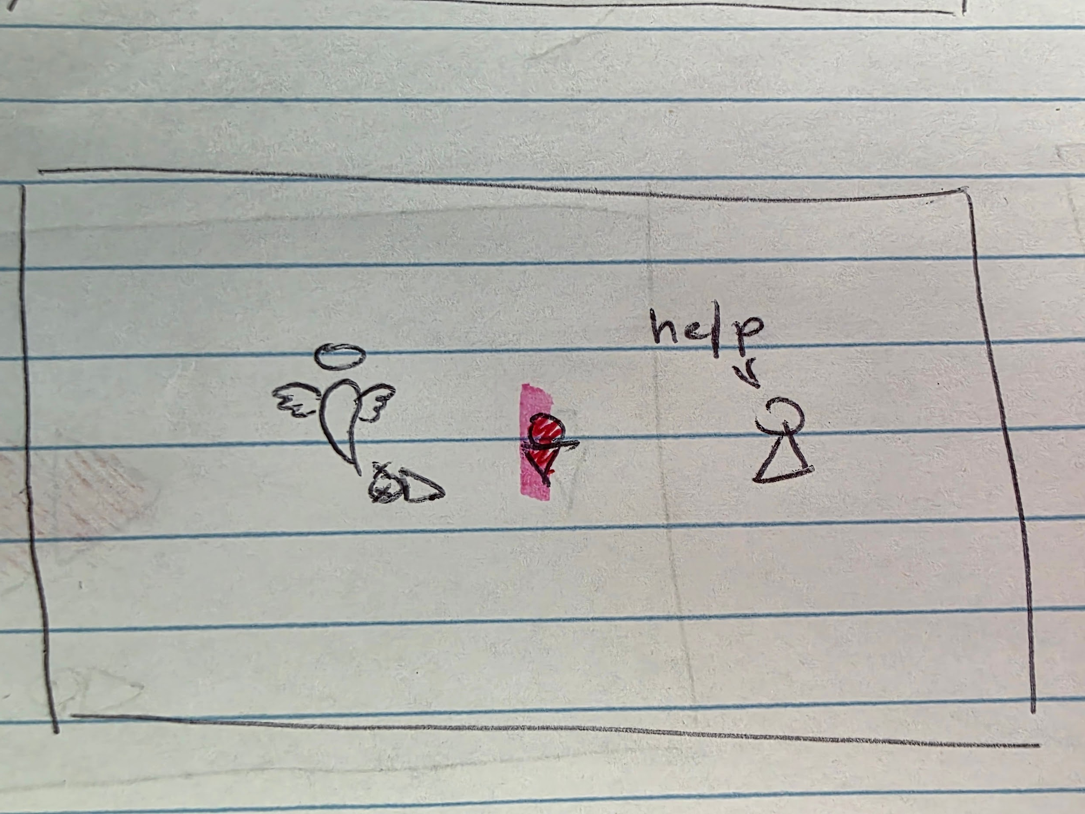
Inscribed Narrative
Exposition
Knight dies fighting leaving behind the NPC that needed help.

Slide 8
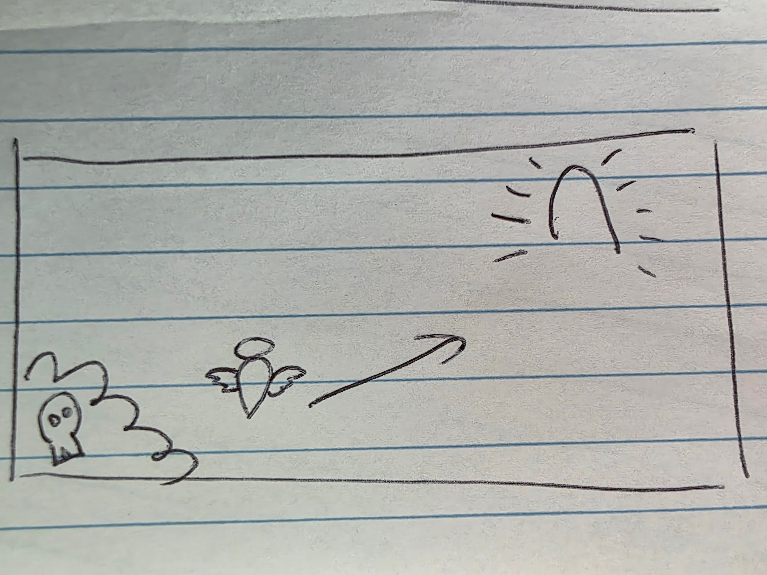
Inscribed Narrative
Exposition
Knight does not actually die and instead escapes the afterlife and revives.

Slide 9
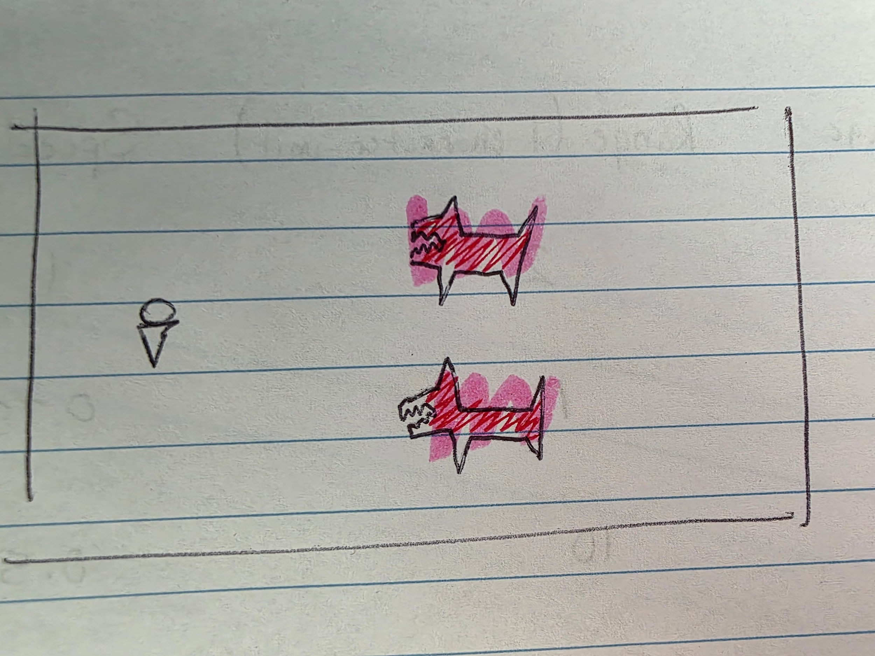
Inscribed Narrative
Rising Action
Knight wakes up in the upper floors of the dungeon and encounters monsters he must defend himself. Knight decides he must make his way back to the final room and that NPC.

Slide 10
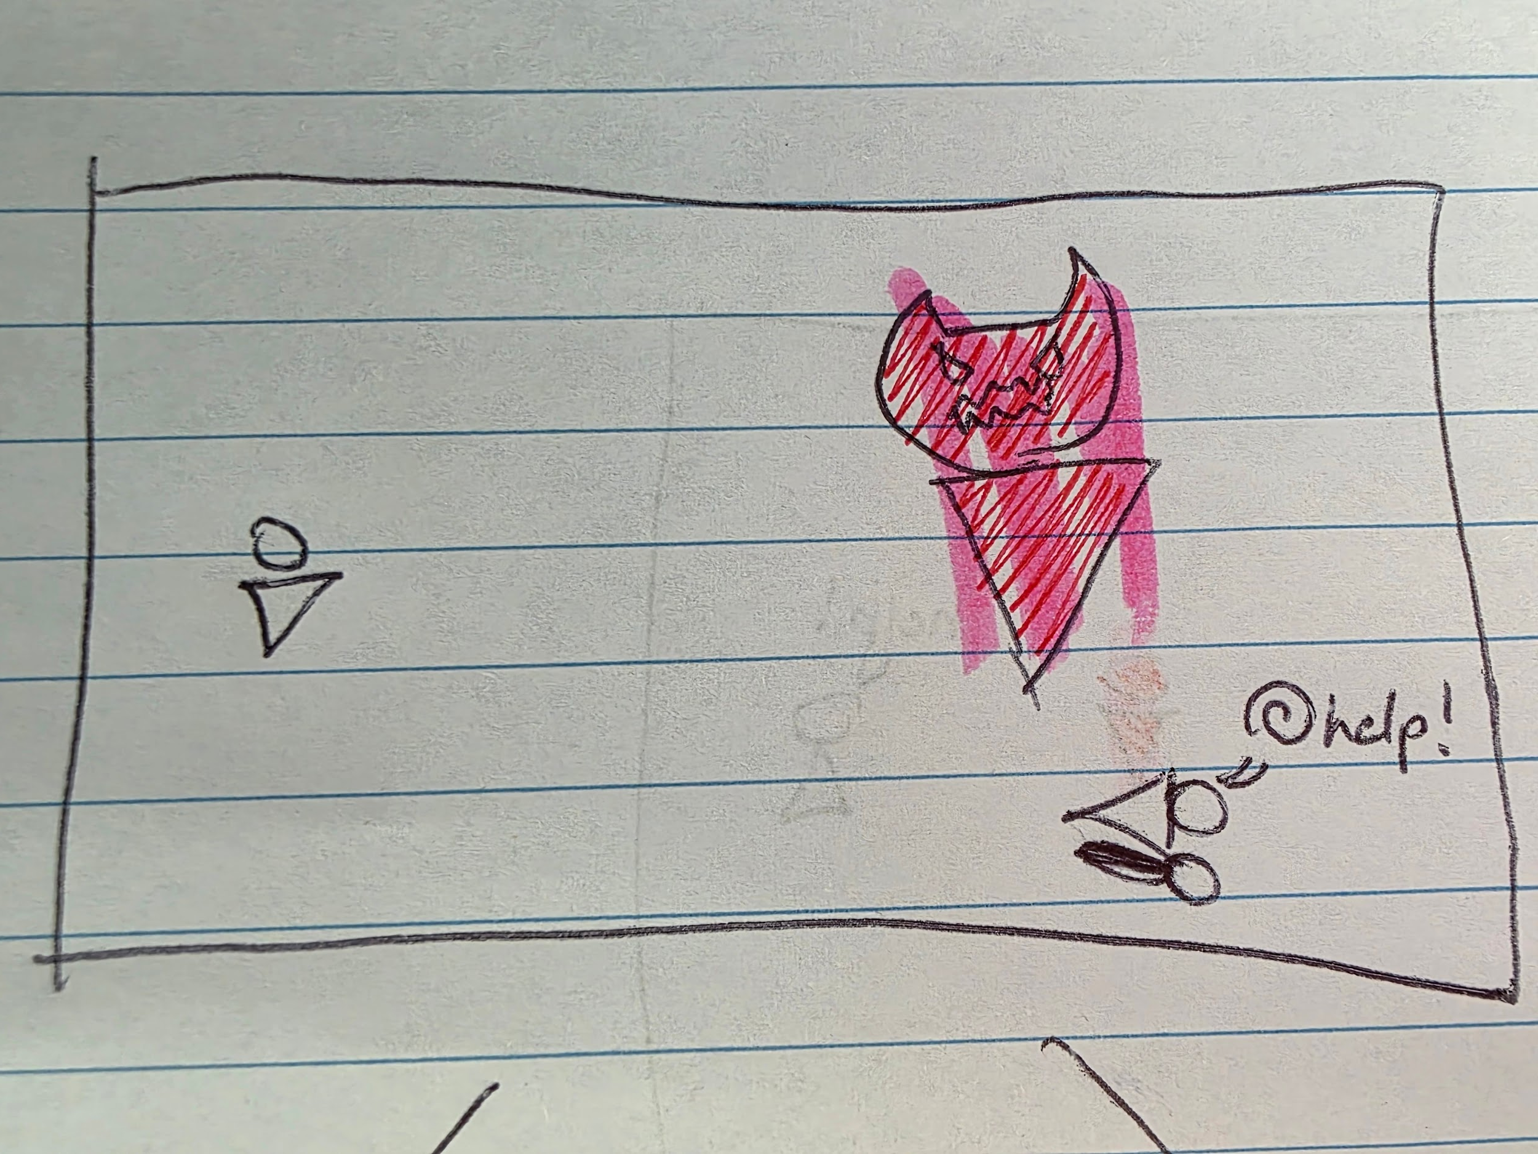
Inscribed Narrative
Rising Action
While fighting a floor boss monster the Knight encounters a dying adventurer NPC.

Slide 11
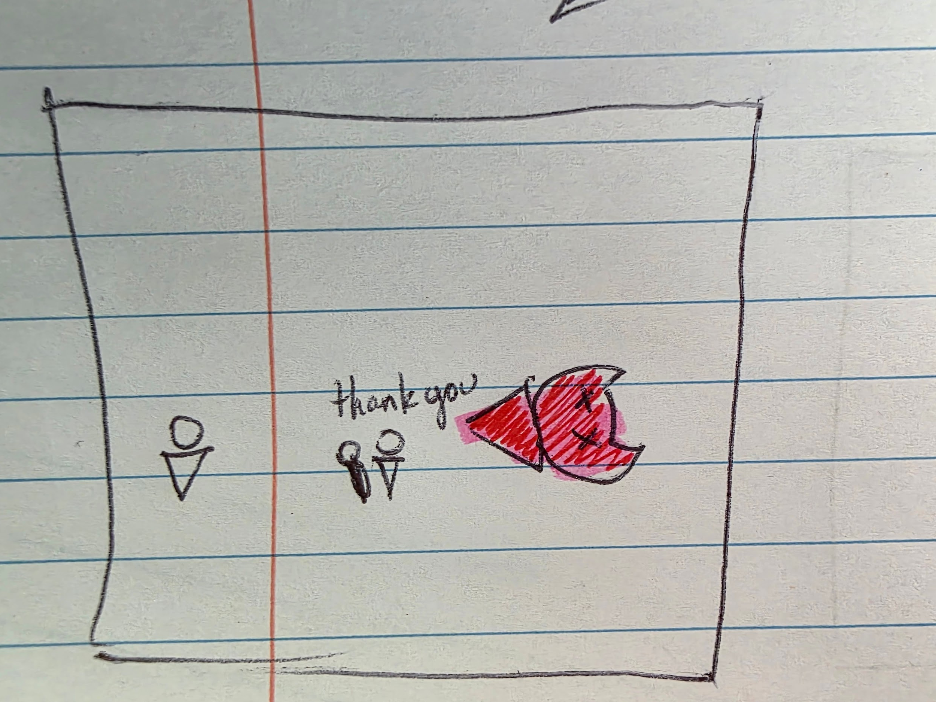
Inscribed Narrative
Rising action
If the Knight manages to defeat the floor boss quick enough then they have the choice to save the adventurer, who after being saved decides to continue exploring the dungeon and runs ahead of the knight.

Slide 12
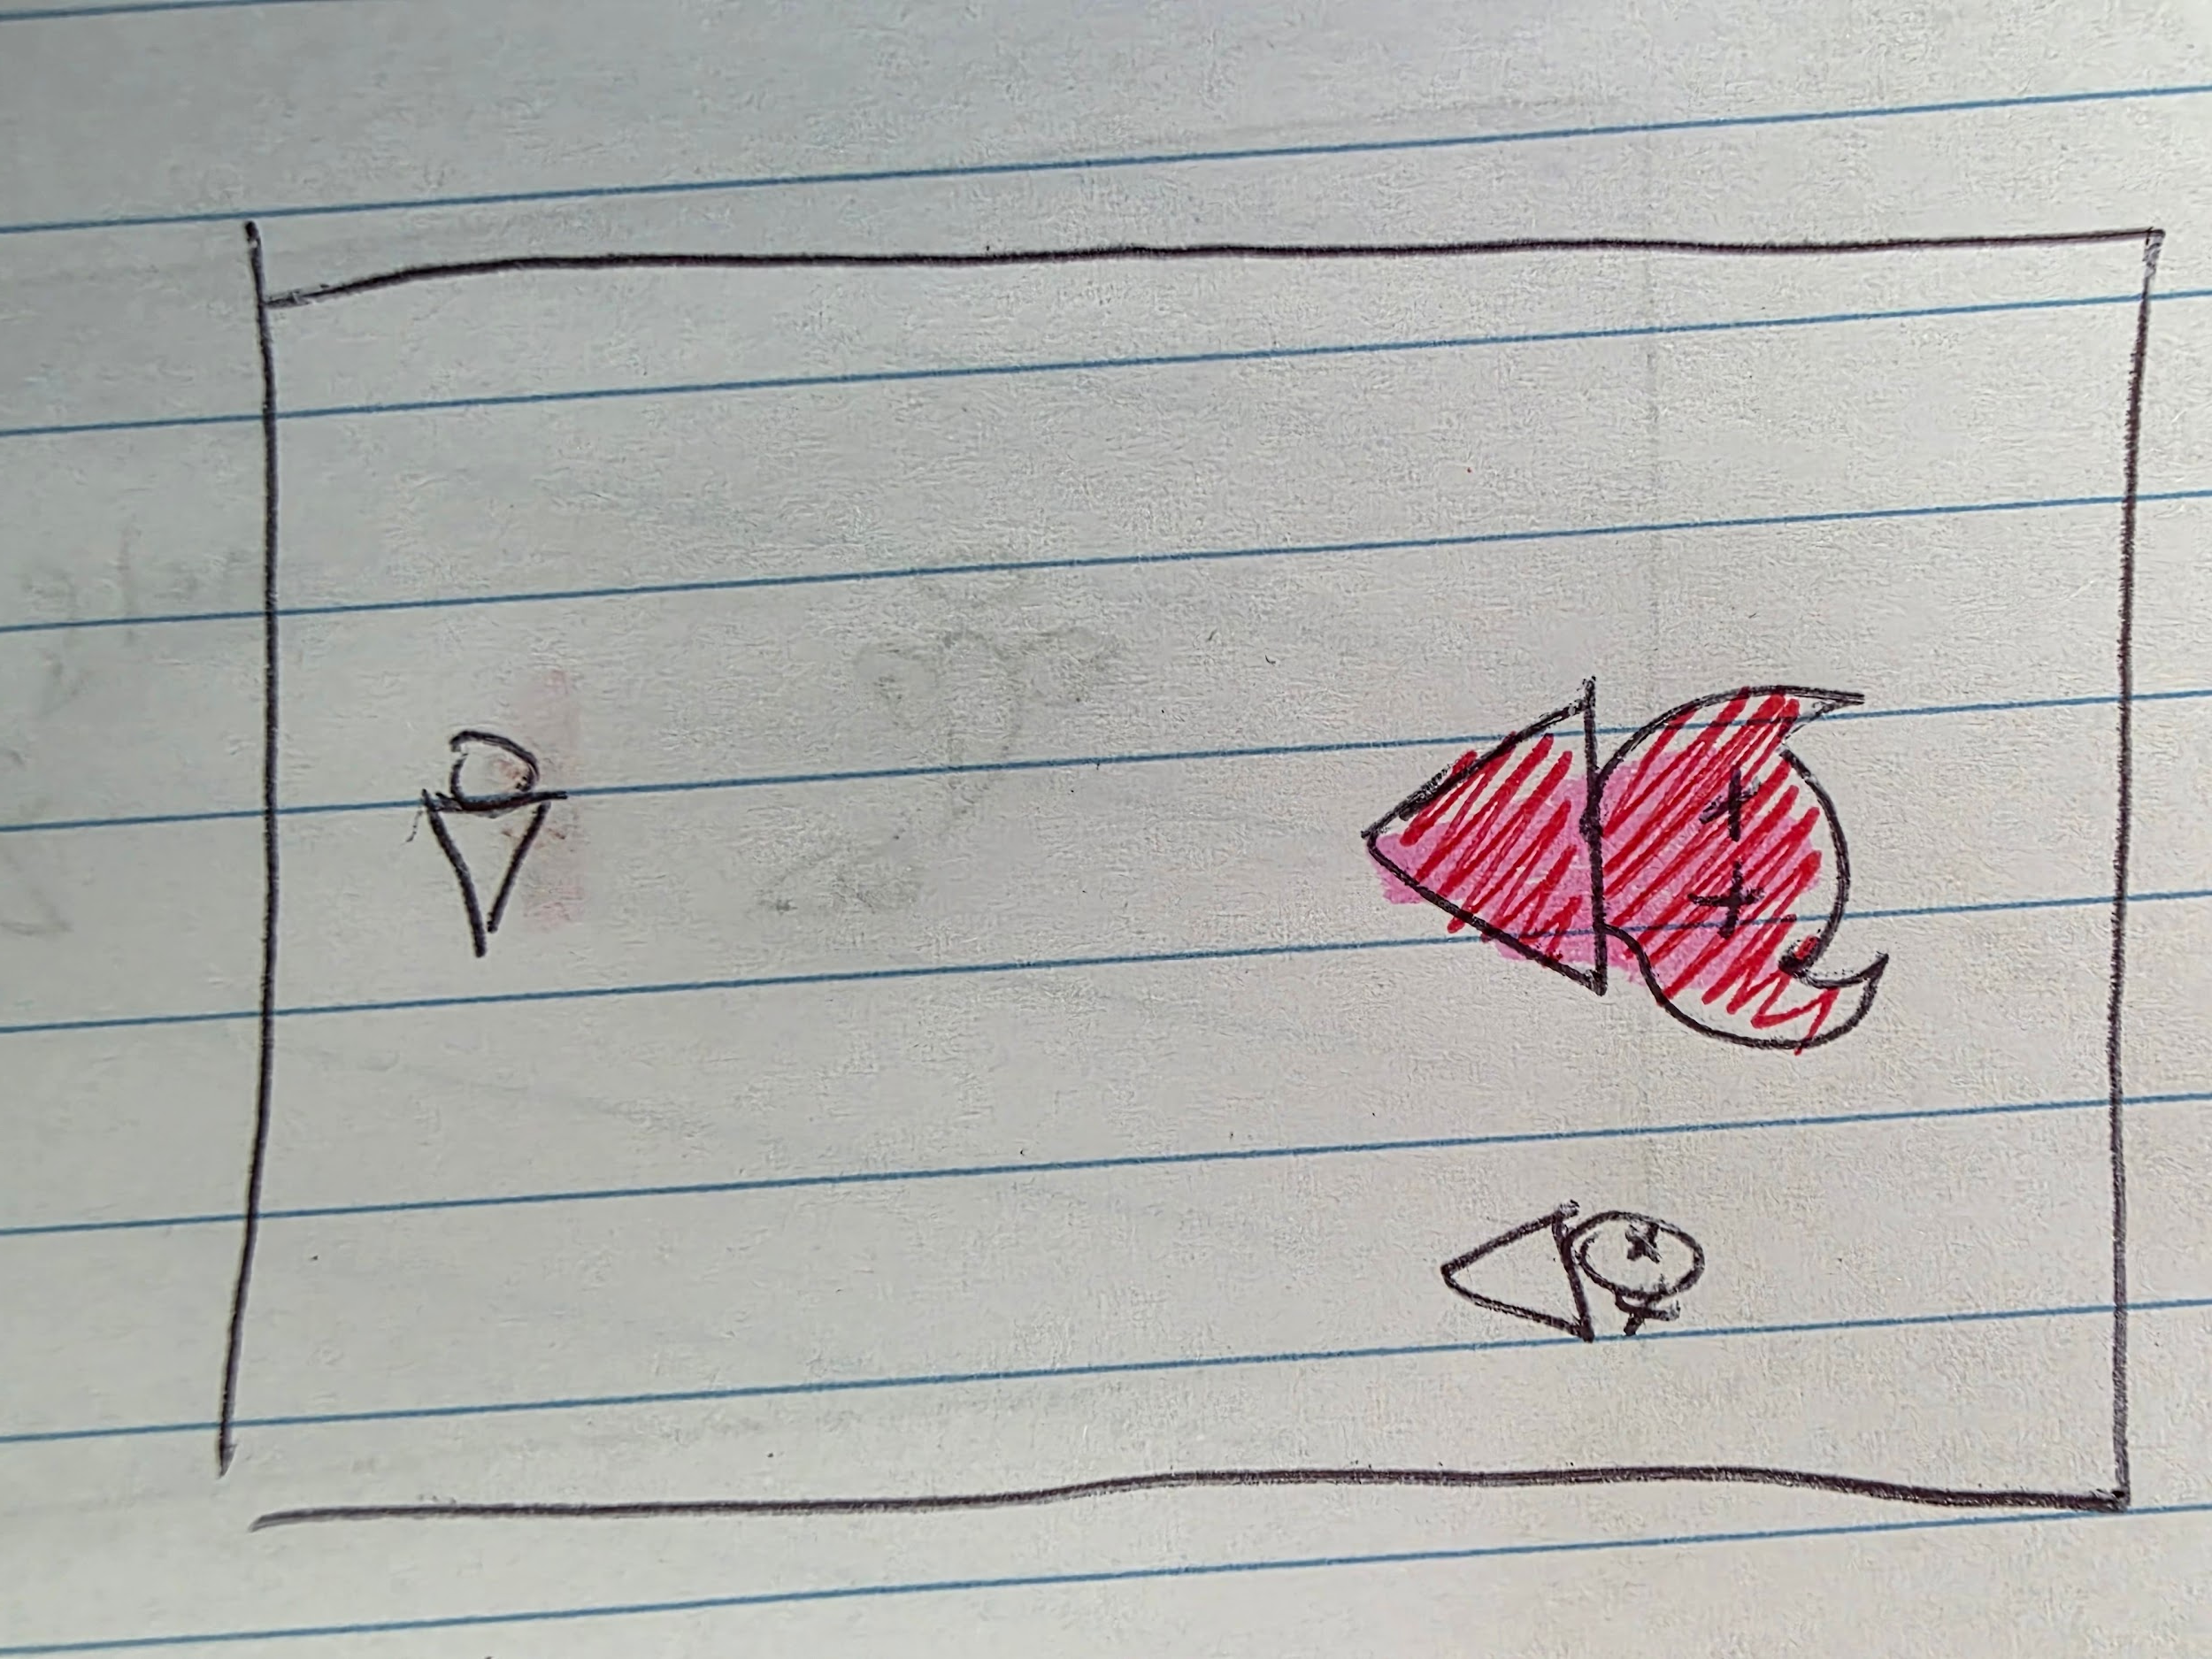
Inscribed Narrative
Rising action
If the knight chooses not to save the adventurer or they do not defeat the boss quick enough then the adventurer dies.

Slide 13
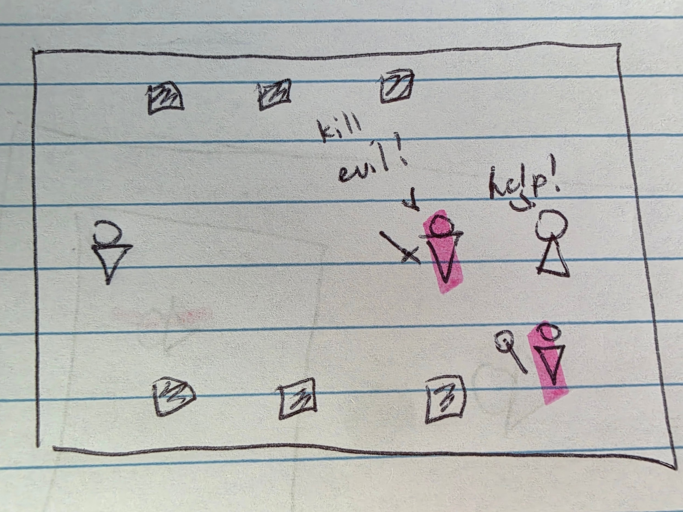
Inscribed Narrative
Climax
Knight arrives at the final boss room again and encounter the one that killed them as well as the adventurer if the knight had saved them previously. Through the dialogue between the adventurer and your killer it is revealed that they are an adventuring party together and reveal that you are in fact the final boss of the dungeon and have revived again surprisingly quickly.

Slide 14
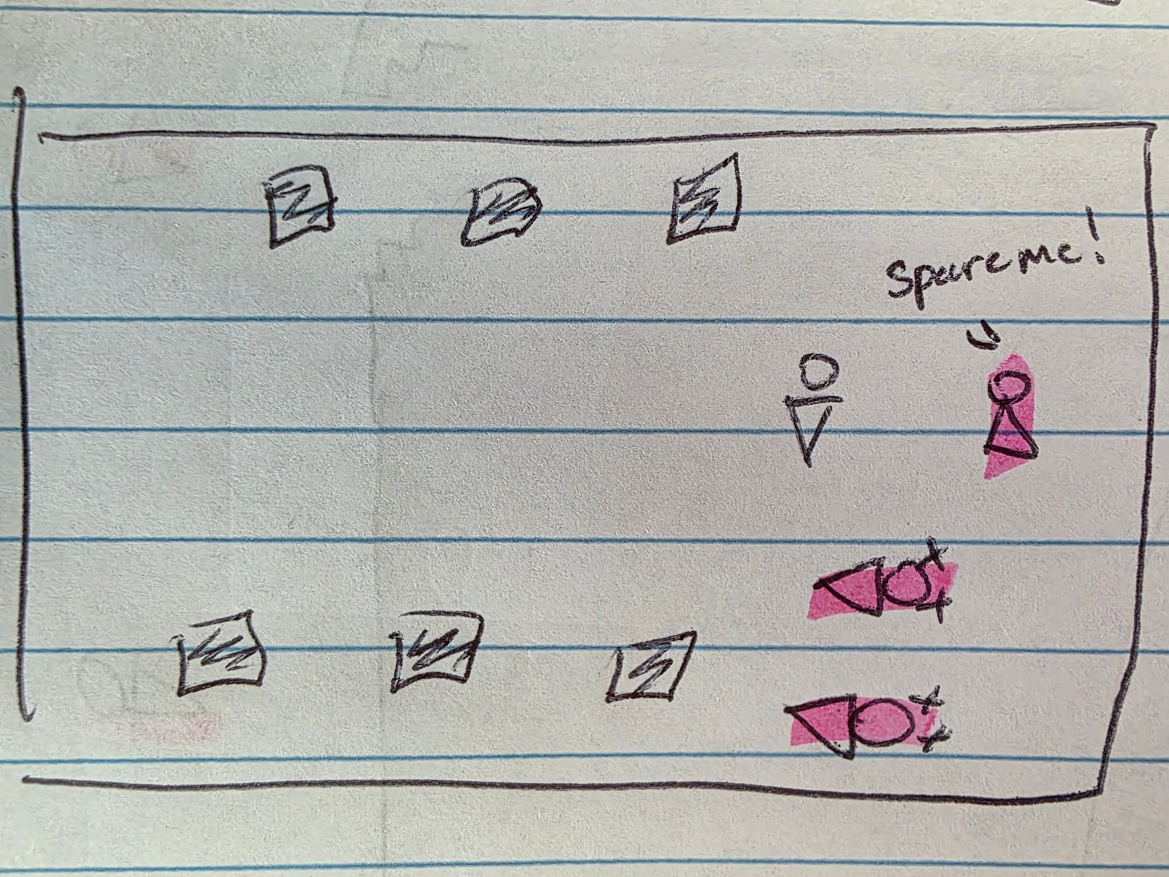
Inscribed Narrative
Falling action
The knight fights the adventurers and upon killing them the knight comes face to face with the pleading NPC from before.

Slide 15
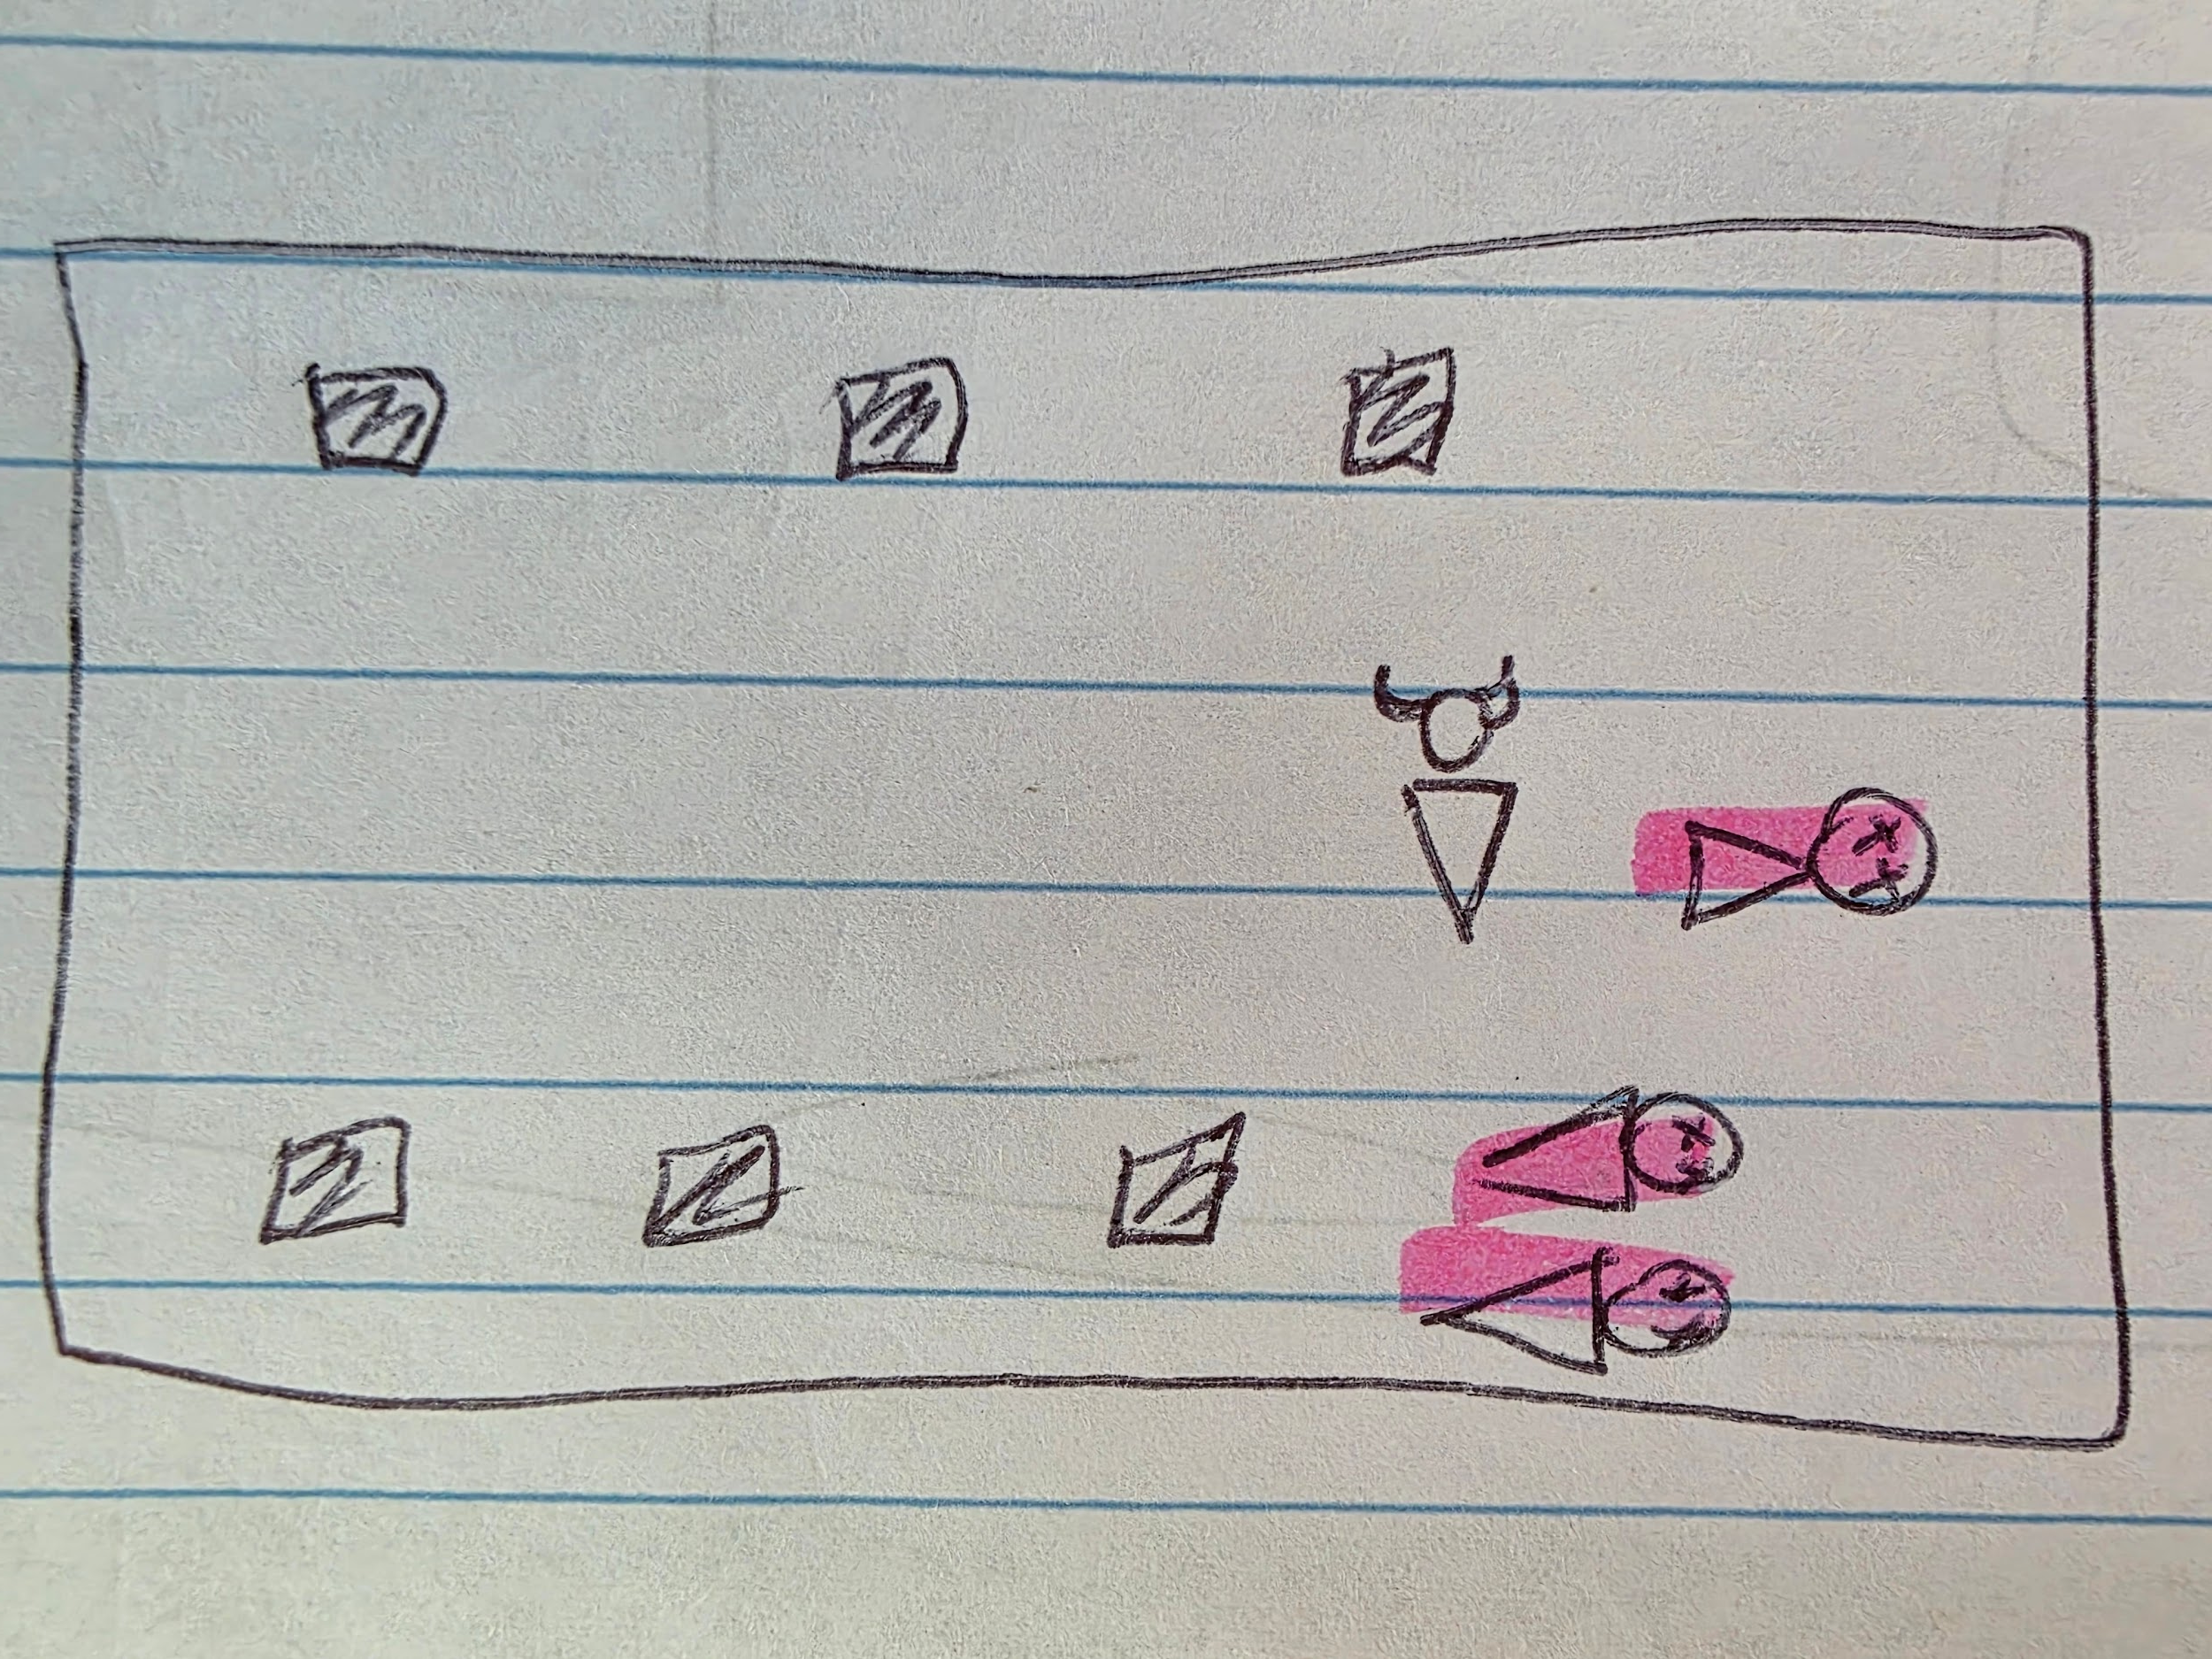
Inscribed Narrative
Falling action
The knight kills the NPC as well and proceeds past all the dead bodies to a room hidden in the back.

Slide 16
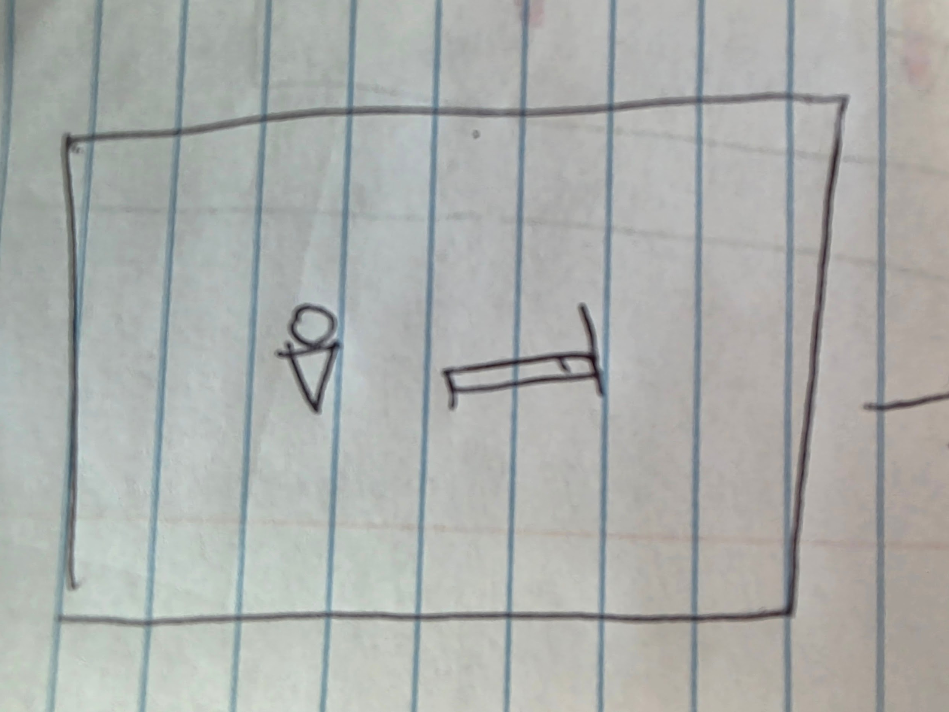
Inscribed Narrative
Denouement
The knight approaches a bed.

Slide 17
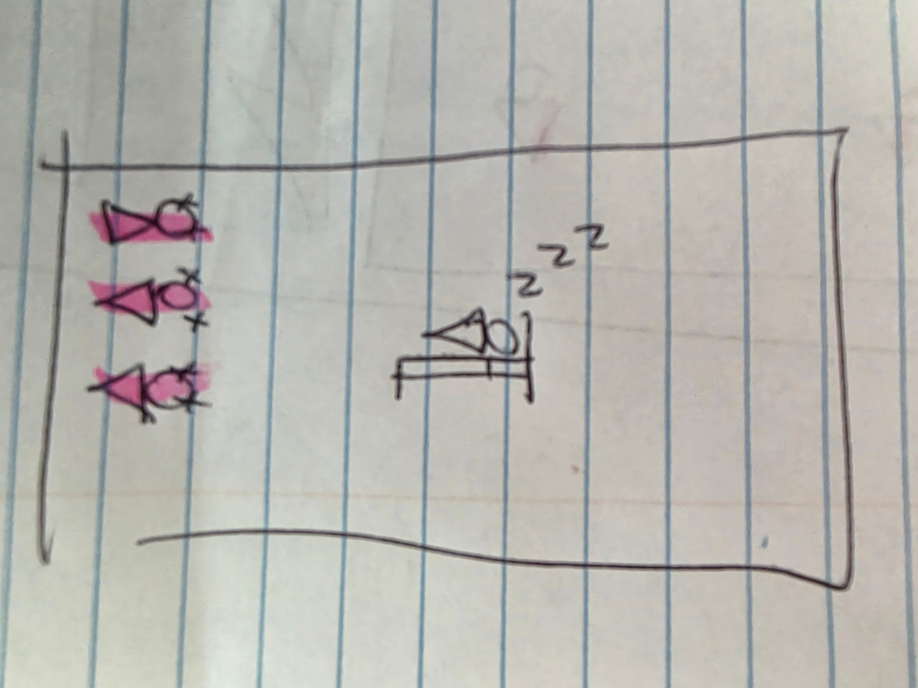
Inscribed Narrative
Denouement
And falls asleep…

Slide 18
Inscribed Narrative
Linear Narrative
The game follows a linear narrative since there is no choices the player makes that will change the ending of the story. The knight will always have to fight through the dungeon and ultimately fight the adventurers in the end. The players choice to save adventurers along the way only serves to add more information about the knight and make the final battle more difficult.

Slide 19
Inscribed Narrative
Evoking emotion
The narrative may evoke curiosity over why the knight did not actually die, and a desire to seek revenge on their killer and possibly save the NPC that seemed to be pleading for help behind their killer.

Slide 20
Inscribed Narrative
Motivation and justification
The player believes they are an adventurer that was killed by the final boss of the dungeon while trying to save someone. This gives them motivation and justification for exploring the dungeon and fighting floor bosses to make progression back towards the final boss room where they were killed.

Slide 21
Inscribed Narrative
Progression and reward
Due to how the game is set to be pseudo rogue-like, meaning death is permanent and all progress is reset other than unlockables, it is difficult to tie the players game progression with any narrative. The player can make small progression rewards like exploring a new floor after successfully defeating a floor boss and unlocking a new weapon.

Slide 22
Inscribed Narrative
Mechanics reinforcement
In the first fight, the player is introduced to dodge rolling and parrying through quick time events. Dodge rolling allows for a short dash with invincibility frames and is the main survival tool for the players but has a short cooldown. Parrying does not have a cooldown, but can only be performed on highlighted enemy attacks. On successful parry, the players next attack gets bonus damage. Other than the introduction the these mechanics in the first fight regular mob monsters the player encounters more frequently attack with parry-able attacks allowing the player to practice with the mechanic. For dodge rolling, many rooms have obstacles or hazards that the player must dodge roll through in order to traverse the rooms letting them get accustomed to the distance of the roll and the amount of i-frames.

Slide 23
Dynamic Narrative
Interactive fiction
Because the game follows a linear narrative, the players choices do not affect the overall narrative of the game. The choices the player makes only reveal more about the knights background.

Slide 24
Dynamic Narrative
Emergent narrative
The player may notice hints that the knight is not actually human and is in fact one of the many monsters that roam the dungeon. More specifically the final boss of the dungeon. This is hinted by the fact that the knight never actually speaks, glides across the ground rather than taking any steps, and the knight never dies and seemingly respawns. This fact more explicitly revealed by the final fight.

Slide 25
Cultural Layer Narrative
How I envision players take control
Whether they save the npcs or not

Slide 26
Cultural Layer Narrative
Fan Fiction
What are the other dungeons and adventurers
The perspective of the adventurers

Slide 27
Cultural Layer Narrative
Narrative Game mods
The adventurers perspective as they climb the ranks of adventurers and get strong enough to challenge one of the 5 famous dungeons and the story of them fighting through the dungeon and encountering the player character

Slide 28
Cultural Layer Narrative
Machinima
Unity or RPG maker

Slide 29
Cultural Layer Narrative
News media
This game is like a dollarstore version of Hades. And its kinda hard.

